Slide 1
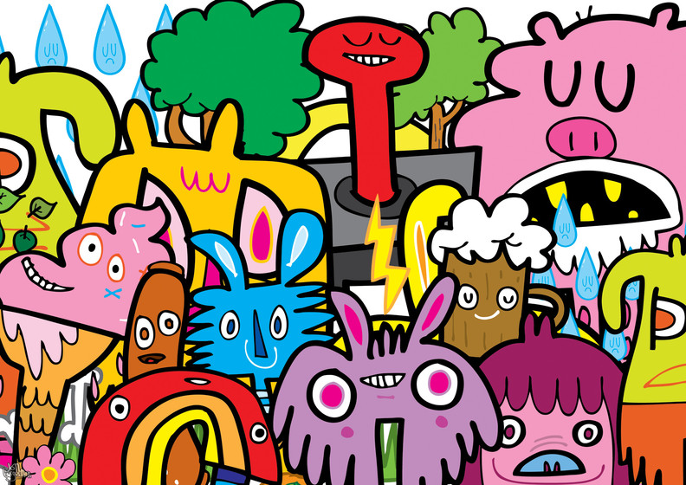
Jon Burgerman
Fun with doodles

Slide 2
Who is Jon Burgerman
Jon Burgerman is originally from Nottingham and studied fine art at Nottingham Trent University
He now lives in New York
He is famous for his ‘doodles’
His work can be seen on Little Big Planet
He has also produced work for Nike, Levis, Puma, Pepsi and MTV

Slide 3
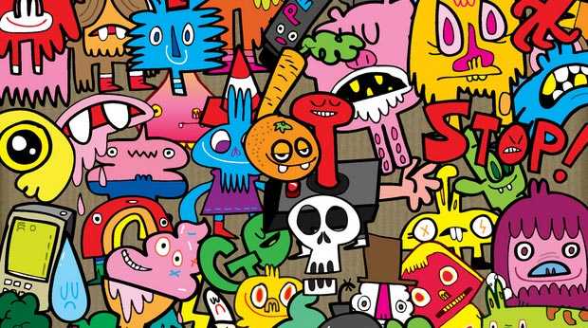
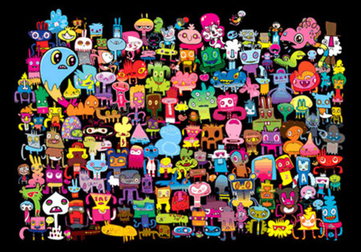
Doodle Characters
His characters come in all shapes and sizes

Slide 4
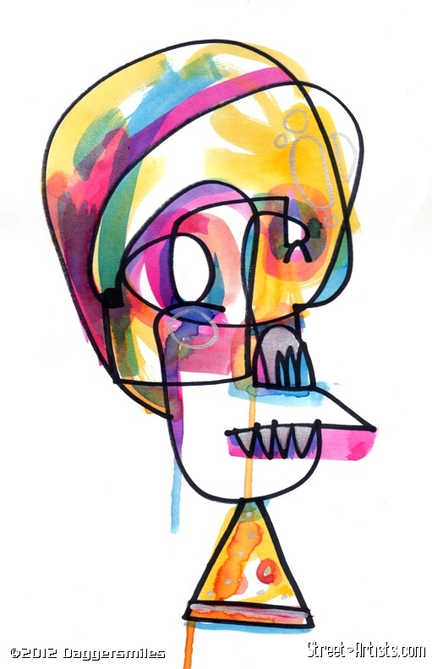
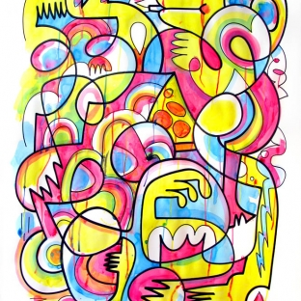
Just with one line

Slide 5
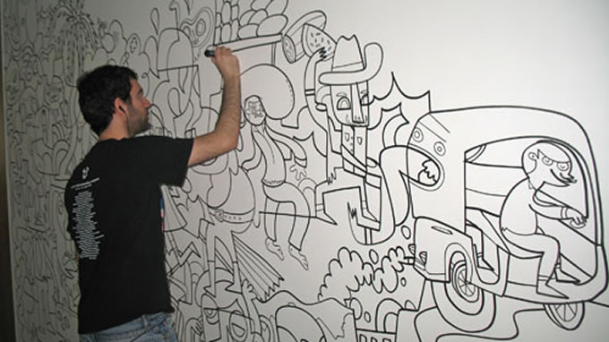
Walls
Some of his work is on a huge scale and covers entire walls.

Slide 6
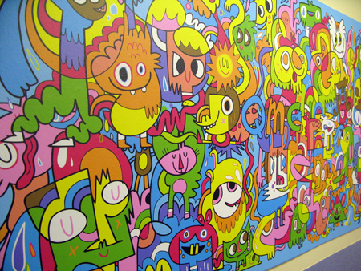
Walls

Slide 7
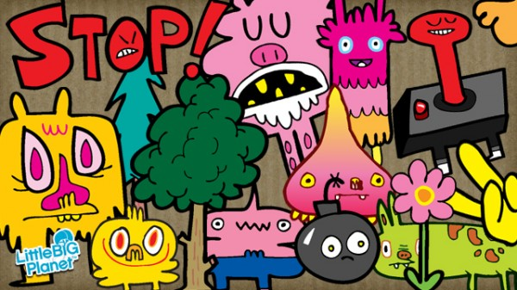
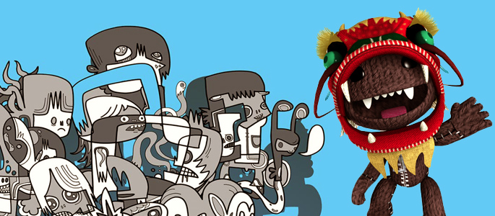
Little Big Planet
Jon Burgerman designed some of the many stickers that you can find on LBP

Slide 8
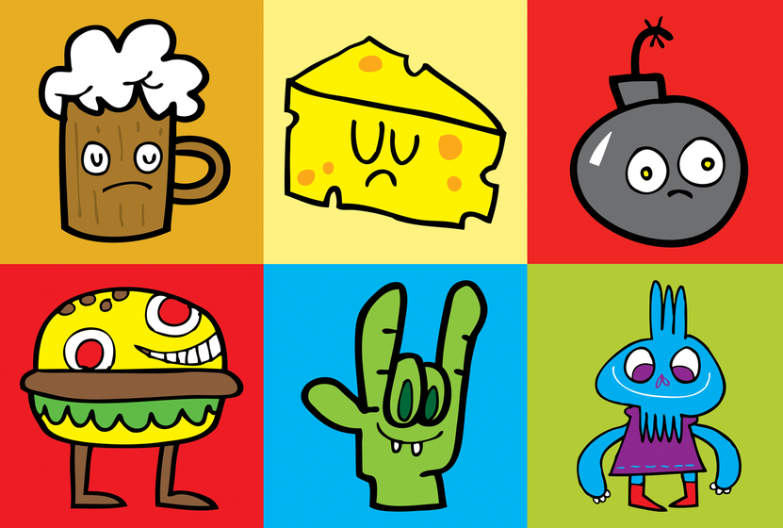
Characters
Bold black outlines.
Simple drawings.
Bright, flat colours.

Slide 9
Our Pictures
What object best describes you.
Make it simple.
Make it bright.
Make it bold.

