Slide 1
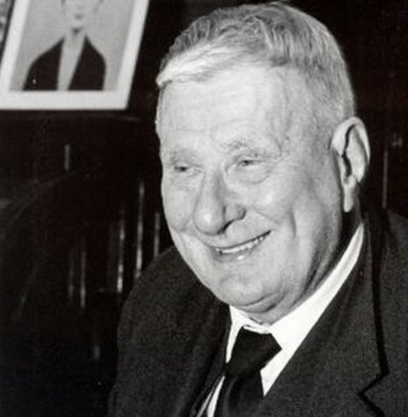
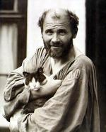
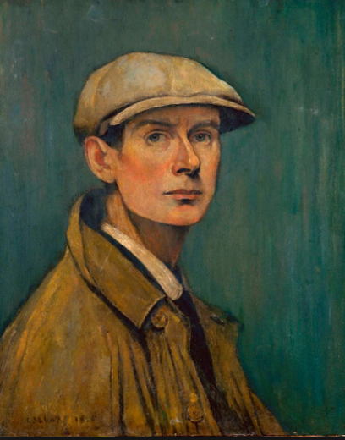
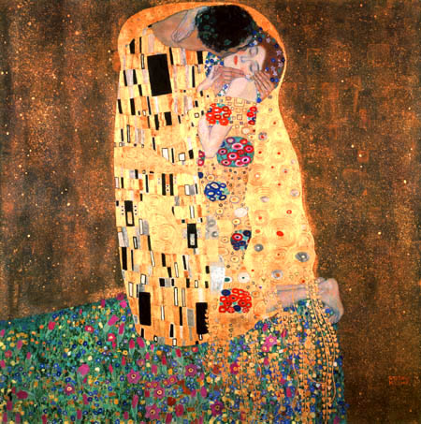
Laurence Stephen Lowry We are learning to research and criticise the work of L.S Lowry.
Self Portrait 1925
Name____________________________________________
Year_____________________________________________

Slide 2
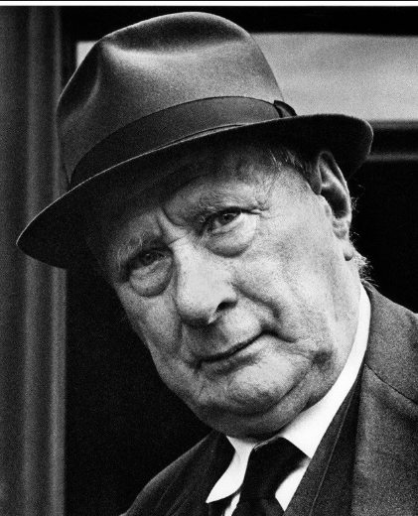
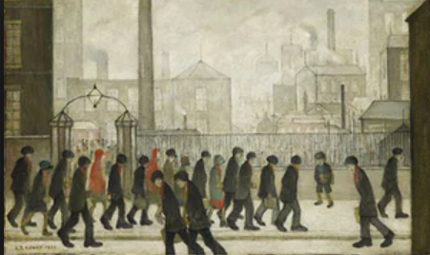
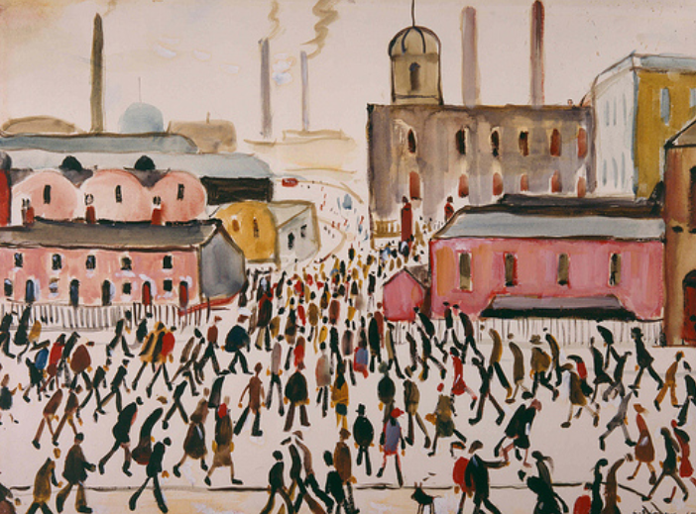
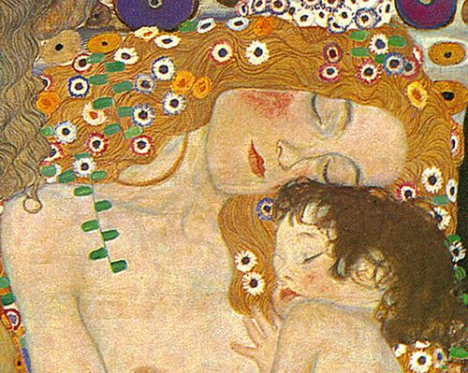
L.S Lowry
Date of birth: 1/11/ 1887 in Stretford, Lancashire.
Nationality: British
Date of death: 23/2/1976. He was aged 88
Lowry is famous for painting scenes of life in the industrial districts of North West England in the mid-20th century. He developed a distinctive style of painting and is best known for his urban landscapes peopled with human figures..
Lowry’s industrial scenes are frequently full of crowds; they show figures going here and there often leaning forward with heads down, bracing themselves against the wind and the elements or simply moving onwards with a determination to get to their destination.
Highlight 6 keywords in the text above.

Slide 3
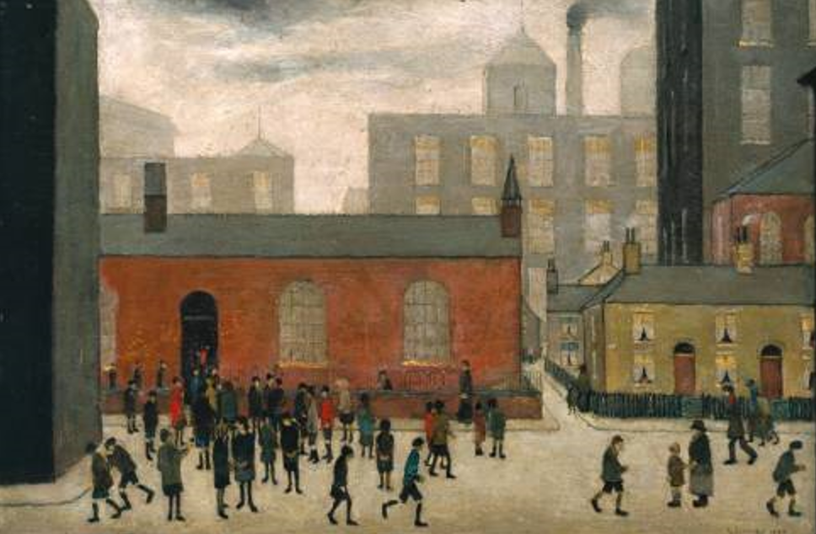
Artwork Analysis
WHO = who do you think the people are?
__________________________________________________________________________________________________________
WHY= why do you think they were painted?
____________________________________________________________________________________________________________
WHEN= when do you think it was painted?
________________________________________________________________________________________________________________
WHERE= where do you think it was painted?
________________________________________________________________________________________________________________
Describing what you think of the artwork.
__________________________________________________________________________________________________________________________________________________________________________________________________________________________________________________________________________________________________________________________________________

Slide 4
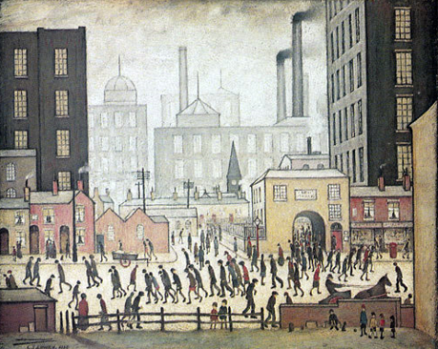
What do you think this painting is called?
____________________________________________________________
Describe some key characters?
________________________________________________________________________________
________________________________________________________________________________________________________________________________________________________________________________________________________________________________________________________________________________________
Where do you think they are going?
_____________________________________________________________________
Where have they been?
__________________________________________________________________
Why do you think they are stooped?
________________________________________________________________________
Choose one figure from the painting and copy it.
Art
To improve my work today I could?
Design Faculty
Date

Slide 5
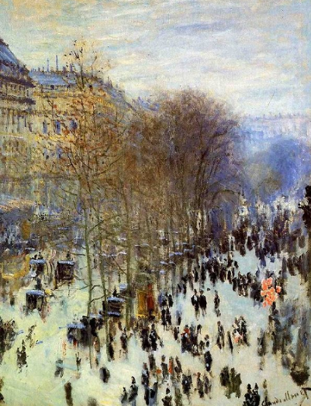
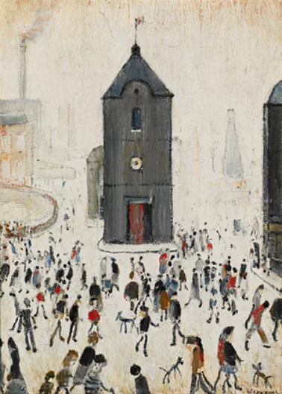
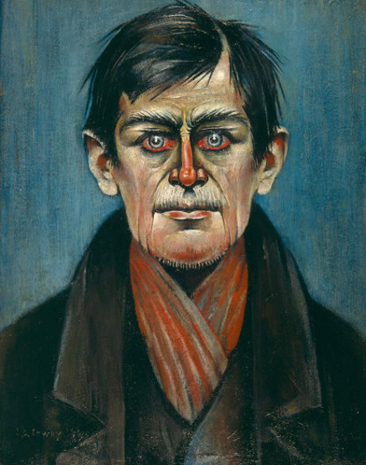
Compare and Contrast Discuss comparisons and contrasts.
Boulevard des Capucines, 1873 Monet.
The Black Church, 1964 Lowry.
How is the artwork similar?
How is the artwork different?
Detail of Boulevard des Capucines.
Detail of The Black Church.
Whose work do you prefer and why?
Why do you think the artist produced the art work?

Slide 6
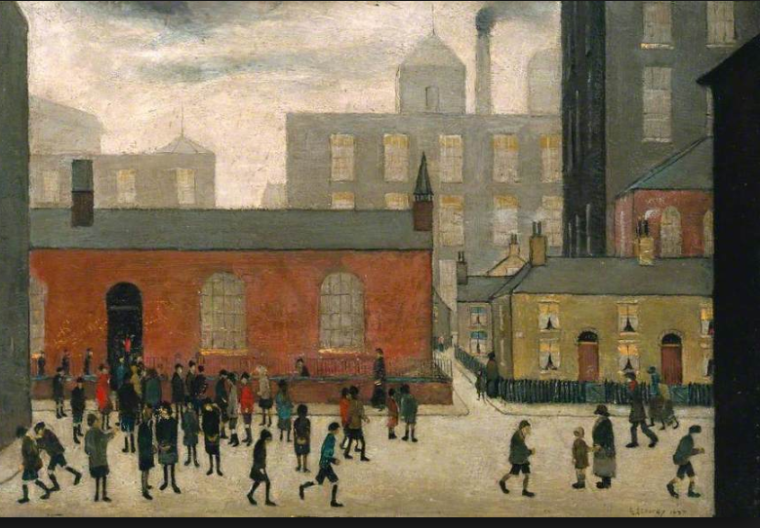
Coming out of School, 1927
Like many of Lowry's pictures this is not a depiction of a particular place, but is based on recollections of a school seen in Lancashire. Lowry's combination of observation and imaginative power often produced images which capture a deeply felt experience of place, with which others could identify.
Draw your own copy of this painting in the style of Lowry.

Slide 7
Evaluation
Look back over your work- list 10 words that you think should be keywords for this project:
Make notes about what you like and dislike about Lowry’s art work.

