Slide 1
Years 9, 10, and 11 Art Worksheets S1w3&4
On the following pages are two of the questions (starting points) from this years gcse exam paper.
Included on them is artwork created by artists that could be described as coming under that theme. Using the sheets work through the following tasks.
Task 1
Around the question/theme , (or on a clean sheet if you prefer) jot down words, ideas or simple images that relate to the theme/question. Write as many as you can (see example).
Task 3
Research at least 1 artist from either of the pages and choose 1 of their artworks. Tell me: the tittle of the work, what it is you like or dislike about that particular piece in your own words.
Task 2
On a separate sheet write or draw your ideas for art work that could be created from the starting points you created in task 1. (You will not be asked to make these so you can be as creative as you possible can.)
Describe how 1 of your ideas could be made.
Example:
Disguise
Buried treasure
Concealment
Camouflage
Hidden/hidding

Slide 2
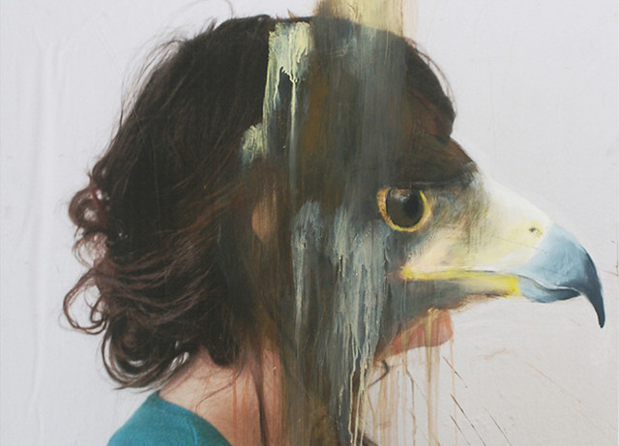
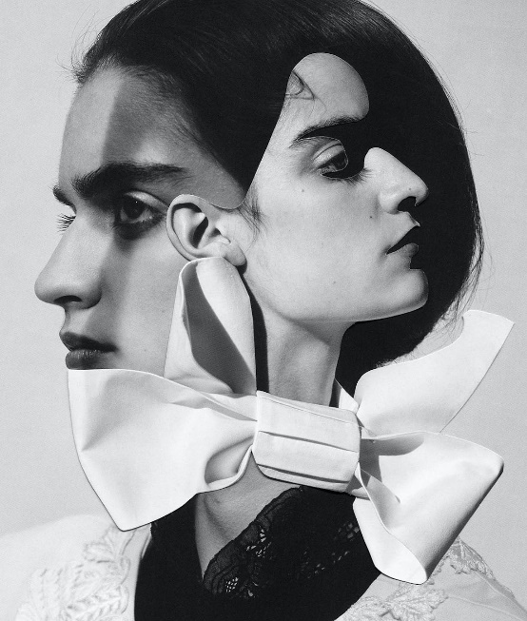
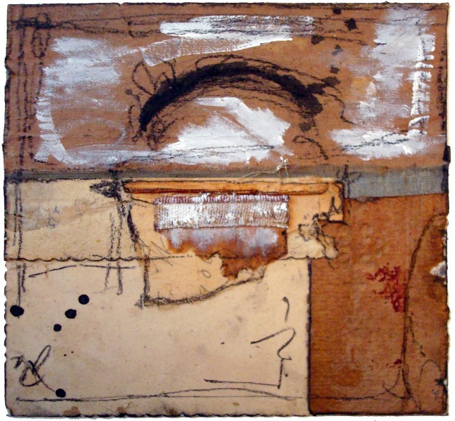
Concealment
Sometimes artists use concealment to hide or disguise identity or hidden meaning in their work.
Around this page are some example of artists’ work who do this.
Charlotte Caron
Pablo Thecuadro
Crysal Neubauer
Other Artists you could research:
Viktor Koen
Danika Pistekova

Slide 3
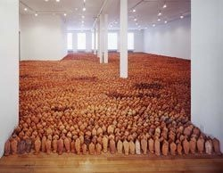
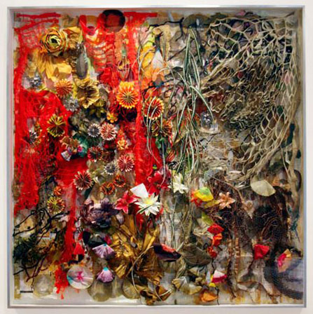
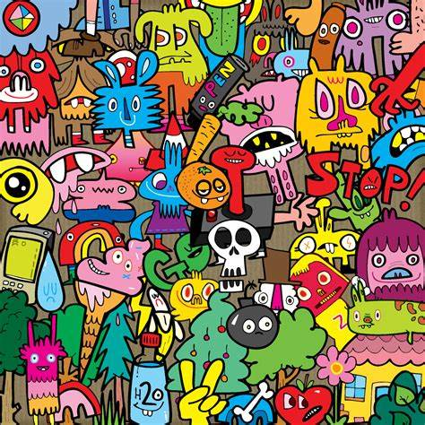
Anthony Gormely
Crowded
Many artists, craftspeople and designers have created artwork inspired by crowded spaces.
Around this page are some example of artists’ work that do this.
Judy Pfaff
Jon Bergerman
Other Artists you could research:
Alex Prager
Dan Perfect
Susan Lenz

