Slide 1
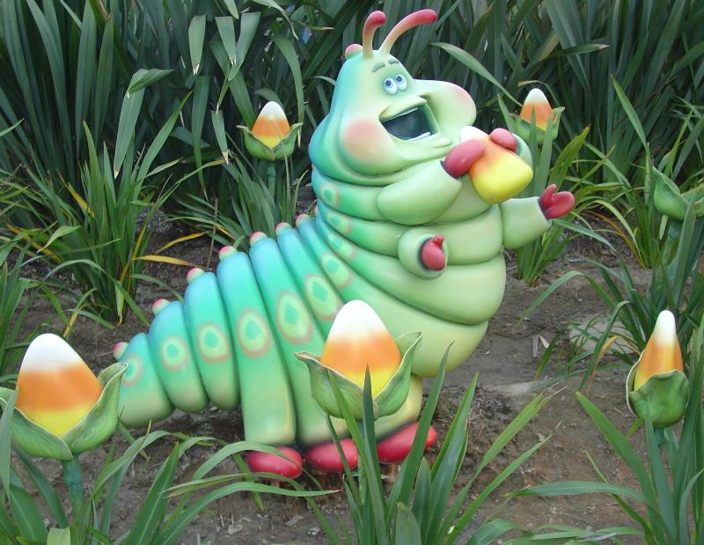
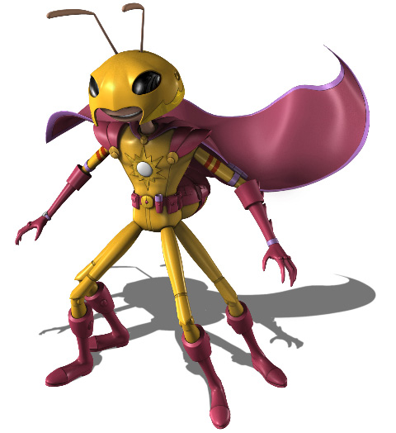
Design your own “SUPERBUG”

Slide 2
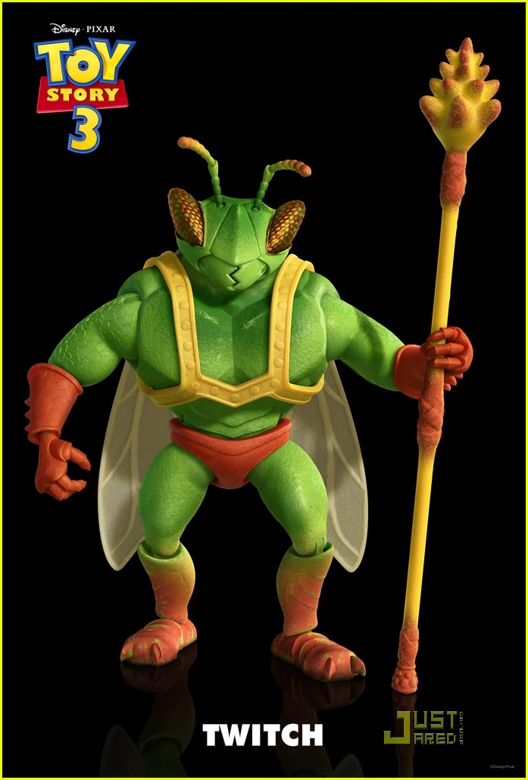
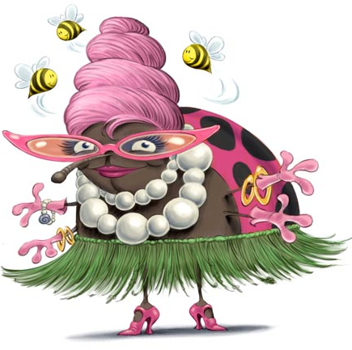
Ideas for Superbug!
What super powers could these superbugs have?

Slide 3
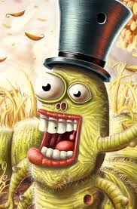

Slide 4
IDEAS!
Ability to Create Fire
Ability to Stretch
Mind Control
Granting Wishes
Run Up Walls
Super Strength
Super Speed
Super Intelligence
Invisibility
Time Control
Task 1
Create a mind map of superpowers.
Use this to help you design your superbug

Slide 5
Learning Objective
Develop your creative thinking skills by designing a SUPERBUG!
Develop your drawing skills.
Task 2:
Produce a pencil drawing of a superbug
1. Create a mind map of ideas and then draw up the basic shapes of your superbug.
2. Try to add costume and any accessories or objects your superbug may use.
3. You could - label all the superpowers!

Slide 6
Learning Objective:
Develop colour blending and shading techniques
Task 3:
Add colour to you SUPERBUG
1. Add colour to all sections of you superbug
2. Try to use colour blending and shading techniques to make your superbug look more three-dimensional or
3. You could use pens to add fine details, patterns or words to describe your creation.

Slide 7
Example of a completed Superbug by a year 8 student!

Slide 8
Extension:
Think about who your Superbug’s enemy would be.
Produce a drawing of the enemy.
Describe their super powers!
Who would win in a battle and why?

