Slide 1
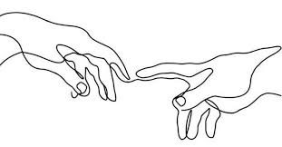
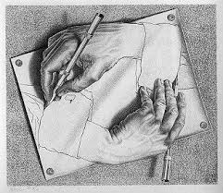
More practise looking and drawing

Slide 2
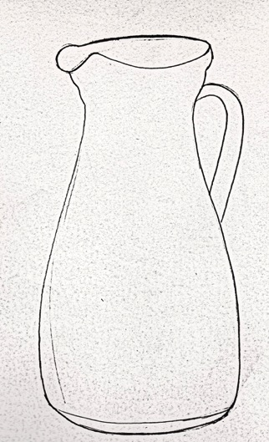
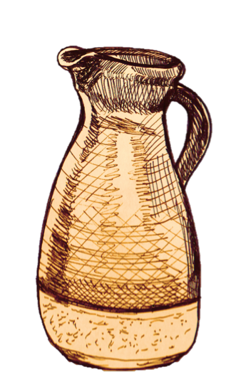
Objectives
Compare 2 different drawing techniques.
Draw objects using different experimental drawing techniques.
Activities:
Create a tonal range to develop mark-making skills.
Draw an object from observation using different techniques.
Continue to practice - complete a detailed drawing of a leaf

Slide 3
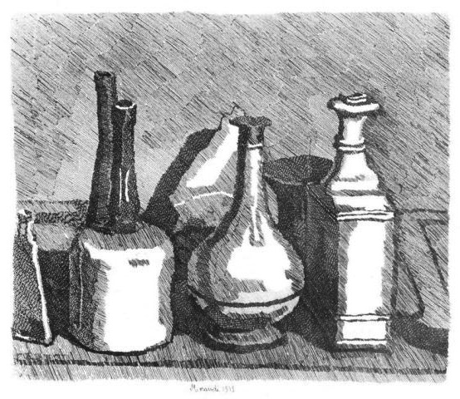
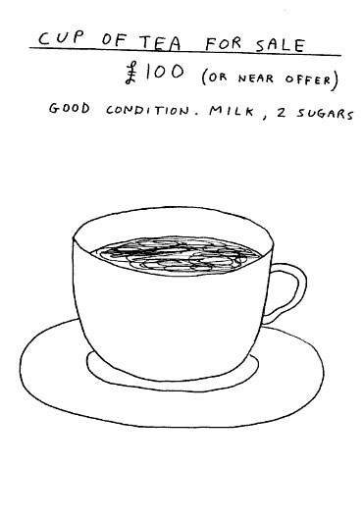
Compare these drawing techniques
Morandi ‘Still Life’
1933
Shrigley ‘Cup of Tea’ 2012

Slide 4
Task 1
Complete the tonal range grid below my example.
Remember to use different experimental mark making techniques for exciting textures as shown above
Eg. Shadding, cloud of tone, multi layered cross hatching and groups of lines in a different directions.

Slide 5
Start Drawing
You will need:
Paper, Pencil, Rubber, Object
TASK 2
Complete a line drawing of an object in front of you
TASK 2 (cont)
Draw the same object using tone, mark making and shading techniques
Compare your drawings
Which do you like best?
Why?
Evaluate your line drawing

Slide 6
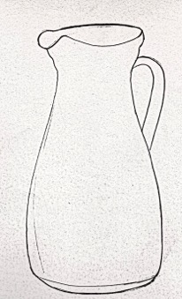
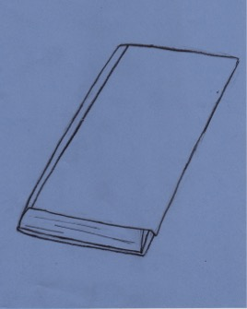
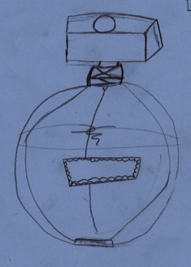
Line drawing in pencil
Evaluate your line drawing
Accurate scale and proportions.
Attention to detail and decoration.
Remember it takes practice to be excellent!
Excellent
Strong
Scale and proportion.
Drawn confidently.
Good
Shapes are
mostly
accurate in
scale and proportion.
Standard
Shapes are
drawn with
some accuracy
of scale and proportion.

Slide 7
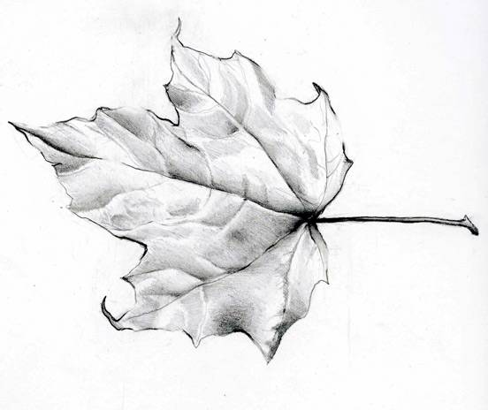
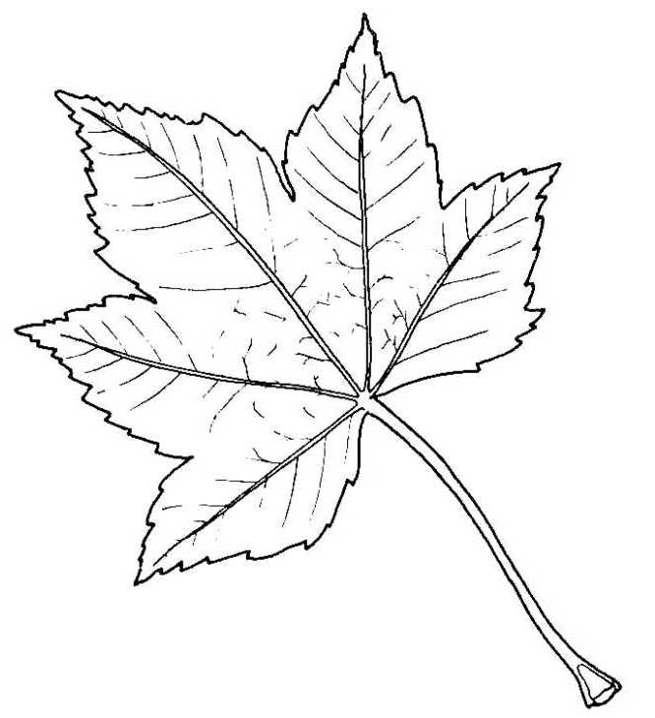
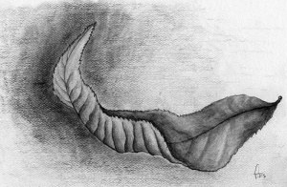
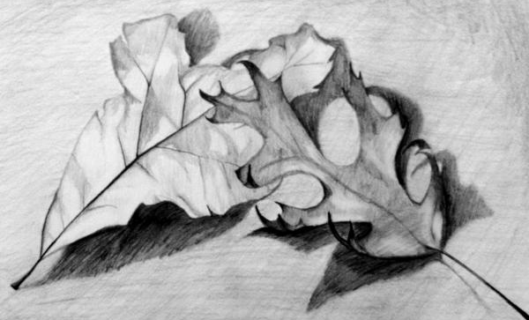
Which is the most challenging drawing?
TASK 3
Complete your own line drawing of a leaf from observation.
Task3 (cont) either add as much detail and tone as you can to your line drawing
Or complete a brand new drawing adding marks, tone, details etc.

