Slide 1
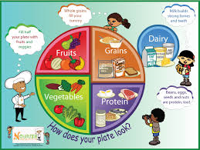
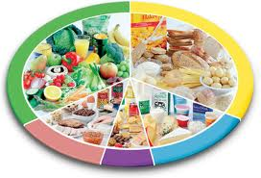
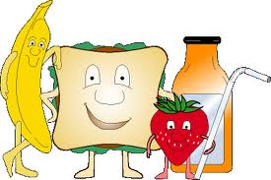
What are we looking at today?

Slide 2
What do you already know?
What is this called?
Do you know why it is split into sections?
Do you know the names of any nutrients?
Can you describe the difference between macronutrients and micronutrients?
Can you name the two different types of vitamins?

Slide 3
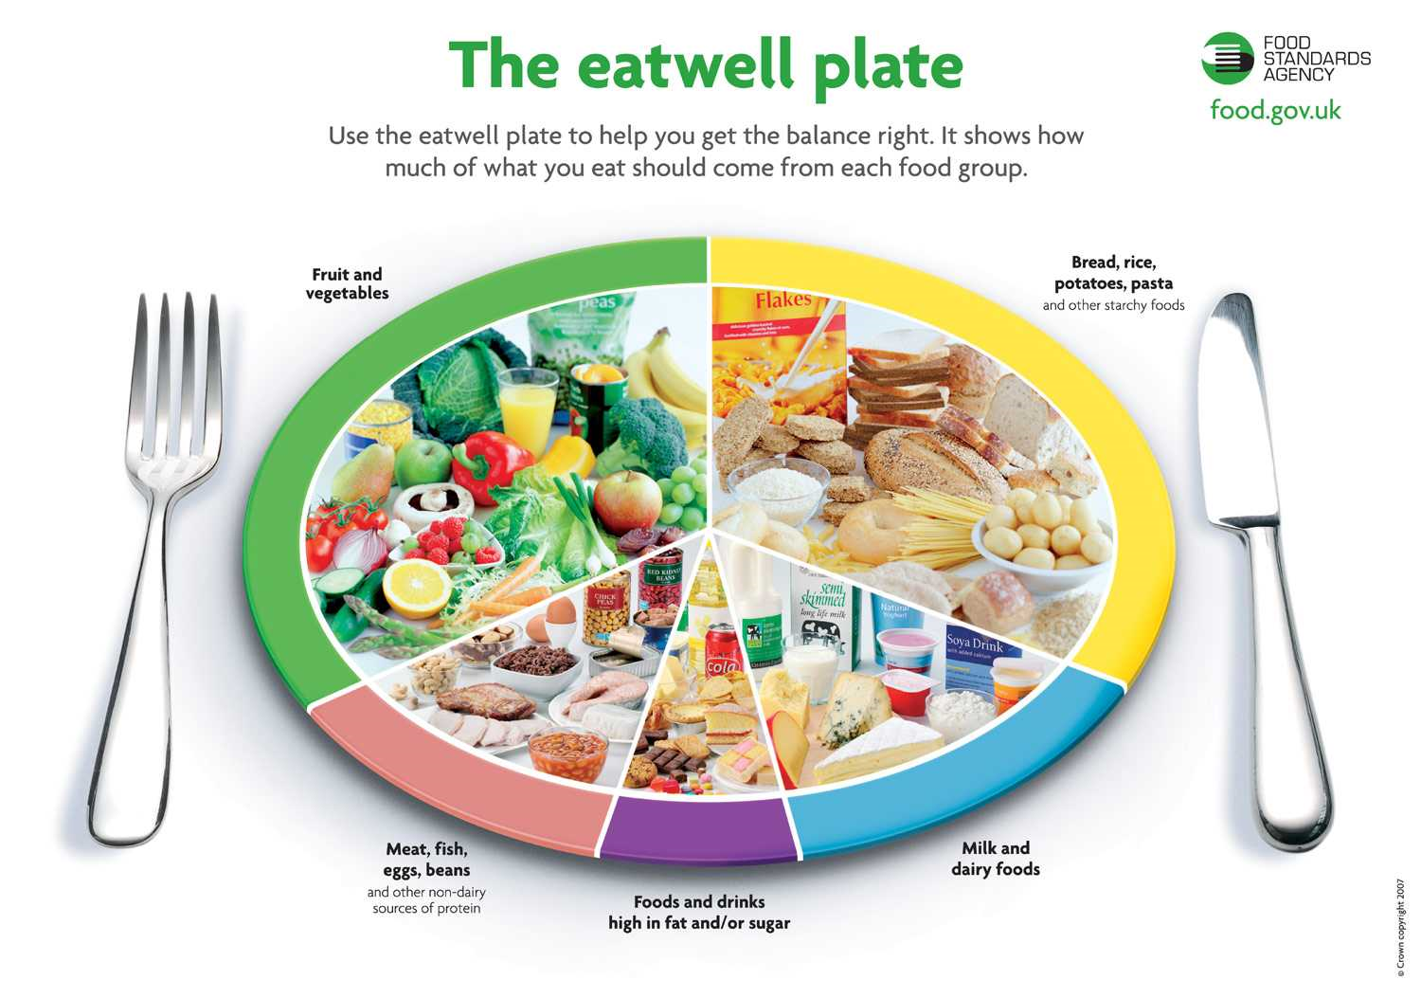

Slide 4
Carbohydrates
Information 1
Carbohydrates can be broken down into 2 main sections.
Complex carbohydrates
Simple carbohydrates.
Simple carbohydrates are also called sugars. They have no real nutritional value. They release energy into the body quickly as they are broken down rapidly.
Complex carbohydrates contain starch are found in a number of foods. If you look at the eat well plate, you will find that most starchy foods are in the yellow section.
Eating too many simple carbohydrates can cause tooth decay and weight gain.
Athletes, such as Usain Bolt, eat many starchy foods. This is because starchy foods slowly release energy into our bodies.
Wholegrain varieties of starchy foods, and potatoes – particularly when eaten with their skins on – are good sources of fibre. Fibre can help to keep our bowels healthy and can help us to feel full, which means we are less likely to eat too much.

Slide 5
Information 2
Protein
There are 22 amino acids, your body can make 13 of them without you ever thinking about it. Your body can't make the other nine amino acids, but you can get them by eating protein-rich foods.
Protein is needed to build, repair and maintain the body tissues. Your muscles, your organs, and your immune system are made up mostly of protein
Protein from animal sources, such as meat and milk, is called complete, (HBV)because it contains all nine of the essential amino acids
Your body uses the protein you eat to make lots of specialized protein molecules that have specific jobs. For instance, your body uses protein to make hemoglobin (say: hee-muh-glow-bin), the part of red blood cells that carries oxygen to every part of your body.
Most vegetable protein is considered incomplete (LBV) because it lacks one or more of the essential amino acids.
When you eat foods that contain protein, the digestive juices in your stomach and intestine go to work. They break down the protein in food into basic units, called amino acids (say uh-mee-no a-sids). The amino acids then can be reused to make the proteins your body needs to maintain muscles, bones, blood, and body organs.
But people who eat a vegetarian diet can still get all their essential amino acids by eating a wide variety of protein-rich vegetable foods.
Research:
What does HBV and LBV stand for?
What is protein complementation?

Slide 6
Information 3
Fat
The name — fat — may make it sound like something you shouldn't eat. But fat is an important part of a healthy diet. And little kids, especially, need a certain amount of fat in their diets so the brain and nervous system develop correctly
Dietary fat helps a child’s body grow and develop like it should. Fats fuel the body and help absorb some vitamins. They also are the building blocks of hormones and they insulate nervous system tissue in the body.
Unsaturated fats: These are found in plant foods and fish. These may be good for heart health. The best of the unsaturated fats are found in olive oil, peanut oil, tuna, and salmon
Macronutrients
Carbohydrate, protein and fat are know as macronutrients.
The term macronutrient simply means that the nutrient is needed in large quantities for normal growth and development. Macronutrients are the body's source of calories, or energy to fuel life processes.
Saturated fats: These fats are found in meat and other animal products, such as butter, cheese, and all milk except skimmed. Eating too much saturated fat can raise blood cholesterol levels and increase the risk of heart disease.

Slide 7
Information 4
Vitamins
Which foods are rich in vitamin A?
•milk fortified with vitamin A
•liver
•orange fruits and vegetables (like cantaloupe, carrots, sweet potatoes)
•dark green leafy vegetables (like kale, collards, spinach)
Micronutrients
Vitamins and minerals are knows as micronutrients this is because they are needed in tiny amounts. They are essential however, to keep our bodies healthy.
Fat-soluble vitamins are happy to stay stored in your body for awhile — some stay for a few days, some for up to 6 months! Then, when it's time for them to be used, special carriers in your body take them to where they're needed. Vitamins A, D, E, and K are all fat-soluble vitamins.
The B vitamins are important in metabolic (say: meh-tuh-bah-lik) activity — this means that they help make energy and set it free when your body needs it.
This group of vitamins is also involved in making red blood cells, which carry oxygen throughout your body. Every part of your body needs oxygen to work properly, so these B vitamins have a really important job.
Water-soluble vitamins are different. When you eat foods that have water-soluble vitamins, the vitamins don't get stored as much in your body. Instead, they travel through your bloodstream. Whatever your body doesn't use comes out when you urinate
Which foods are rich in vitamin B?
•whole grains, such as wheat and oats
•fish and seafood
•poultry and meats
•eggs
•dairy products, like milk and yogurt
•leafy green vegetables
•beans and peas
Vitamin A helps you see in colour, too, from the brightest yellow to the darkest purple. In addition, it helps your body fight infections by boosting your immune system.

Slide 8
Information 4
Vitamin C is important for keeping body tissues, such as gums and muscles in good shape. C is also key if you get a cut or wound because it helps you heal.
It helps your body resist infection. This means that even though you can't always avoid getting sick, vitamin C makes it a little harder for your body to become infected with an illness.
Vitamin D is the vitamin you need for strong bones! It's also great for forming strong teeth. Vitamin D even lends a hand to an important mineral — it helps your body absorb the amount of calcium it needs. Vitamin D is made in the skin when exposed to sunlight, or you can get it from the foods you eat.
Which foods are rich in vitamin D?
•milk fortified with vitamin D
•fish
•egg yolks
•liver
•fortified cereal
Which foods are rich in vitamin C?
•citrus fruits, like oranges
•cantaloupe
•strawberries
•tomatoes
•broccoli
•cabbage
•kiwi fruit
•sweet red peppers

Slide 9
Information 5
Minerals
The body uses minerals to perform many different functions — from building strong bones to transmitting nerve impulses. Some minerals are even used to make hormones or maintain a normal heartbeat.
Iron The body needs iron to transport oxygen from your lungs to the rest of your body. Your entire body needs oxygen to stay healthy and alive. Iron helps because it's important in the formation of hemoglobin (say: HEE-muh-glo-bun), which is the part of your red blood cells that carries oxygen throughout the body.
Which foods are rich in iron?
•meat, especially red meat, such as beef
•tuna and salmon
•eggs
•beans
•baked potato with skins
•dried fruits, like raisins
•leafy green vegetables, such as broccoli
•whole and enriched grains, like wheat or oats
Calcium This mineral helps build strong bones, so you can do everything from standing up straight to scoring that winning goal. It also helps build strong, healthy teeth, for chomping on tasty food.
Which foods are rich in calcium?
•dairy products, such as milk, cheese, and yogurt
•canned salmon and sardines with bones
•leafy green vegetables, such as broccoli
•calcium-fortified foods — from orange juice to cereals and crackers

