Slide 1
Paper One: Checklist
Reading time: 5 minutes
Question 1: Find 4 true statements – 4 minutes
Question 2:
Two paragraphs: 3 mins prep, 8 mins writing
Sophisticated LANGUAGE subject terminology
A range of quotations (two per paragraph)
Have you shown how the technique answers the question? Is this an obvious point, or is it perceptive?
Question 3:
Two to Three paragraphs: 3 mins prep, 10 mins writing
Sophisticated STRUCTURAL subject terminology
A range of quotations (two per paragraph)
Have you shown how the technique interests you? Is this an obvious point, or is it perceptive?
Question 4:
Three to Four paragraphs (or about two sides), 6mins prep, 21 mins writing
Discussed the effect on the reader IN DETAIL
Explained how the techniques are used to create suspense
A range of relevant quotations (3 per paragraph)
Make it clear that you are focusing on the statement.

Slide 2
Do Now:
It’s been a while since we’ve been over Paper One. What can you remember? Write down anything and everything:
Timings
Marks
Skills
Assessment Objectives
Mark Scheme Info
ANYTHING!

Slide 3
The Great Gatsby: Q2&3
1
Wednesday, 28 March 2018

Slide 4
Lesson Objectives:
To revise the skills needed for English Language ‘Explorations in Creative Reading’
To review the Assessment Objectives
To understand the different elements to the exam
To attempt a Q2 and a Q3
Lesson Outcomes:

Slide 5
AQA GCSE English Language
Paper 1 50%
Paper 2 50%
We’ve covered all of the content now – all that’s left is for you to revise. There are only a handful of lessons left!
Please take spare revision PPEs from my desk to practice with. Anything you hand in will be marked with feedback!
Section A:
Reading
1 unseen literature fiction text
Section B:
Writing
Descriptive or narrative writing
Section A:
Reading
1 non-fiction and 1 literary non-fiction text
Section B:
Writing
Writing to present a viewpoint
Total exam time:
1 hour and 45 minutes
Total exam time:
1 hour and 45 minutes
Paper 1: Explorations in Creative Reading and Writing: Tuesday 5th June am
Paper 2: Writers’ Viewpoints and Perspectives: Friday 8th June am

Slide 6
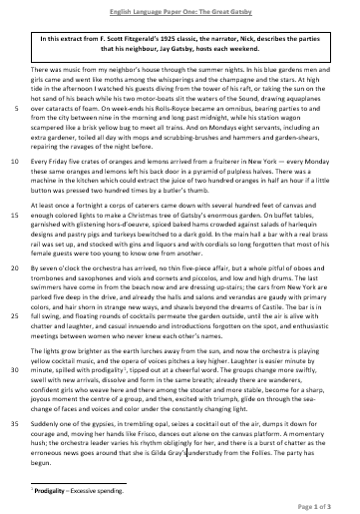
Read
Let’s read the extract. After we have read it, you are going to:
Summarise the plot into three sentences.
Tell me your initial opinion of the text – did you enjoy it? Why? Why not?
EXT: If you were an examiner, what questions would you set for this text?

Slide 7
Question & Mark Scheme
Q2: Read paragraphs 1, 4, 5 and 6 again. How does the writer use language to describe the guests?
You could include:
The writer’s choice of words and phrases
Language features and techniques
Sentence forms
[8 marks]
4 7-8 marks | Shows detailed and perceptive understanding of language: • Analyses the effects of the writer’s choices of language • Selects a judicious range of textual detail • Makes sophisticated and accurate use of subject terminology
3 5-6 marks | Shows clear understanding of language: • Explains clearly the effects of the writer’s choices of language • Selects a range of relevant textual detail • Makes clear and accurate use of subject terminology
Remind me – what is this question asking us to do? What would we need to do to get a good mark? Write these notes down in your book.

Slide 8
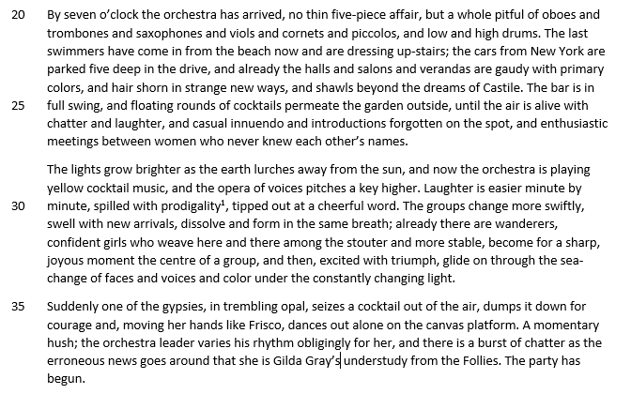
Let’s Annotate Together
Things to look for:
Similes
Pre-modifying adjectives
Syndetic lists
Dynamic verbs
Sentence types
Collective nouns
Figurative language
Sensory description
Personification
Semantic Field

Slide 9
Sentence Starters
You have eight minutes to write two analytical paragraphs. How does the writer use language to describe the guests? [8 marks]
Technique
The writer uses…
In order to describe the guests as…, the writer…
Evidence
This is shown in the quotation…
This is perhaps best demonstrated when…
Explore
The word… has several meanings but the one I think fits best here is…
He chooses the word… here to express…, but also to …
The use of the technique… has been used here as the writer wants to show…
Effect
The writer probably did this to make the reader think…
However, some people could have interpreted it as…
In particular, the word… connotes… which would make the reader…
Use this structure for EVERY quote you analyse. Do NOT tell me the definition of the technique. I am aware of what personification is, thank you.
Banned phrase:
This makes me want to read on because it is interesting

Slide 10
Peer Assess This
HINT: Just because a teacher wrote it, it does not necessarily mean that it is full marks. I want you to engage with the mark scheme, get used to it and use it to tell me where my answer needs more work.
The writer uses lists to describe the guests as quite shallow and artificial. This is perhaps best demonstrated when it says, “The bar is in full swing…introductions forgotten on the spot, and enthusiastic meetings between women who never knew each other’s names.” He chooses the word “forgotten” here to express the casual encounters between guests. They pretend to know and like each other when in the high spirits of the party, but in reality, they do not care at all. They are only interested in themselves and being the “centre of a group”. The writer probably did this to make the reader think that people can be quite superficial and insincere, particularly at social gatherings, where the guests are selfishly only looking out for themselves – a metaphor for society.
Question Two
Level | Skills Descriptors
4 7-8 marks | Shows detailed and perceptive understanding of language: • Analyses the effects of the writer’s choices of language • Selects a judicious range of textual detail • Makes sophisticated and accurate use of subject terminology
3 5-6 marks | Shows clear understanding of language: • Explains clearly the effects of the writer’s choices of language • Selects a range of relevant textual detail • Makes clear and accurate use of subject terminology
2 3-4 marks | Shows some understanding of language: • Attempts to comment on the effect of language • Selects some appropriate textual detail • Makes some use of subject terminology, mainly appropriately

Slide 11
Question & Mark Scheme
Q3: You need to think about the whole extract now. How has the writer structured the text to interest you as a reader?
You could write about:
What the writer focuses your attention on at the beginning
How and why the writer changes this focus as the extract develops
Any other structural features that interest you
[8 marks]
4 7-8 marks | Shows detailed and perceptive understanding of structure: • Analyses the effects of the writer’s choices of structure • Selects a judicious range of textual detail • Makes sophisticated and accurate use of subject terminology
3 5-6 marks | Shows clear understanding of structure: • Explains clearly the effects of the writer’s choices of structure • Selects a range of relevant textual detail • Makes clear and accurate use of subject terminology
Remind me – what is this question asking us to do? What would we need to do to get a good mark? Write these notes down in your book.

Slide 12
Let’s Annotate Together
Things to look for:
How the extract develops:
What happens at the beginning? Why is this interesting?
What happens in the middle? Why is this interesting?
What happens at the end? Why is this interesting?
Sentence types
Punctuation
Syndetic/asyndetic lists
1st/2nd/3rd Person
Cinematic writing
Time shifts
Tense shifts
Other Techniques

Slide 13
Sentence Starters
You have ten minutes to write two to three analytical paragraphs. How has the writer structured the text to interest you as a reader? [8 marks]
Technique
The writer begins the extract by…
In order to interest the reader, the writer…
Evidence
This is shown in the quotation…
This is perhaps best demonstrated when…
Explore
One interesting feature of the structure of this text is…
He chooses the technique… here to interest the reader because…
The use of the technique… has been used here as the writer wants to interest the reader by…
Effect
The writer probably did this to make the reader think…
However, some people could have interpreted it as…
In particular, the technique… would make the reader…
Use this structure for EVERY quote you analyse. Do NOT tell me the definition of the technique. I am aware of what paragraphs are, thank you.
Banned phrase:
This makes me want to read on because it is interesting

Slide 14
Peer Assess This
HINT: Just because a teacher wrote it, it does not necessarily mean that it is full marks. I want you to engage with the mark scheme, get used to it and use it to tell me where my answer needs more work.
The writer concludes the extract by shifting the focus on to an individual character. This is shown in the quotation, “One of the gypsies”. This is an interesting feature of the structure because we see that after all of the complexity of the text so far, one individual manages to stand out above all the rest as she dances and everybody gossips about her with “erroneous news”. In particular, the simple sentence of “The party has begun.” would interest the reader as it represents the gypsy girl. She is a solitary figure in a “sea-change of faces and voices”, and yet she stands out and is drawn to our attention by Fitzgerald. Just like the simple sentence stands out in a “seas” of complex sentences.
Question Three
Level | Skills Descriptors
4 7-8 marks | Shows detailed and perceptive understanding of structure: • Analyses the effects of the writer’s choices of structure • Selects a judicious range of textual detail • Makes sophisticated and accurate use of subject terminology
3 5-6 marks | Shows clear understanding of structure: • Explains clearly the effects of the writer’s choices of structure • Selects a range of relevant textual detail • Makes clear and accurate use of subject terminology
2 3-4 marks | Shows some understanding structure: • Attempts to comment on the effect of structure • Selects some appropriate textual detail • Makes some use of subject terminology, mainly appropriately

Slide 15
Self Assessment
Question Two
Question Three
4 7-8 marks | Shows detailed and perceptive understanding of language: • Analyses the effects of the writer’s choices of language • Selects a judicious range of textual detail • Makes sophisticated and accurate use of subject terminology
3 5-6 marks | Shows clear understanding of language: • Explains clearly the effects of the writer’s choices of language • Selects a range of relevant textual detail • Makes clear and accurate use of subject terminology
4 7-8 marks | Shows detailed and perceptive understanding of structure: • Analyses the effects of the writer’s choices of structure • Selects a judicious range of textual detail • Makes sophisticated and accurate use of subject terminology
3 5-6 marks | Shows clear understanding of structure: • Explains clearly the effects of the writer’s choices of structure • Selects a range of relevant textual detail • Makes clear and accurate use of subject terminology
Read back over your answers. Give yourselves a mark out of 8 and an EBI for each question. Then give yourselves a confidence rating for each question.
1 = You have no clue what is going on ☹.
10 = You got this! ☺

Slide 16
EXT:
Pre-modifying Adjective
Dynamic Verb
Simile
Alliteration
Write a definition or write an example for the following techniques, as I read them out.
Asyndetic List
Declarative Sentence
Metaphor
Semantic Field
Adverb
Ellipsis
Notes:
Differentiate the key terms to suit the ability of your class.

Slide 17
Do Now:
There are four things on the mark scheme for question four. Can you remember what they are?

Slide 18
The Great Gatsby: Q1&4
2
Wednesday, 28 March 2018

Slide 19
Lesson Objectives:
To revise the skills needed for English Language ‘Explorations in Creative Reading’
To review the Assessment Objectives
To understand the different elements to the exam
To attempt a Q1 and a Q4
Lesson Outcomes:

Slide 20
Re-Cap
Briefly, discuss with your partner what you can remember about the ‘Great Gatsby’ extract that we read last lesson. What happened? Who is involved? What was the tone? The purpose? The genre? The intended audience?

Slide 21
Question One
___________________________________
___________________________________
___________________________________
___________________________________
Q1: Read the first paragraph again.
List four things that the neighbour’s guests do.
[4 marks]
Remember: You MUST write in full sentences and you can’t just copy whole sections of the text.

Slide 22
Question One
Q1: Read the first paragraph again.
List four things that the neighbour’s guests do.
[4 marks]
The guests came and went like moths
They dove into the water from his raft
They sunbathed on his beach
They drove his two motor-boats in the water
They partied
They came early
They stayed late
They came from the city
They created a mess
Remember: You MUST write in full sentences and you can’t just copy whole sections of the text.

Slide 23
Question & Mark Scheme
Question Four
Level | Skills Descriptors
4 16-20 marks | Shows perceptive and detailed evaluation: • Evaluates critically and in detail the effect(s) on the reader • Shows perceptive understanding of writer’s methods • Selects a judicious range of textual detail • Develops a convincing and critical response to the focus of the statement
3 11-15 marks | Shows clear and relevant evaluation: • Evaluates clearly the effect(s) on the reader • Shows clear understanding of writer’s methods • Selects a range of relevant textual references • Makes a clear and relevant response to the focus of the statement
Q4: Focus this part of your answer on the whole of the extract. A student said: “F. Scott Fitzgerald successfully brings the party to life for the reader. It is as if you are there in the party.”
To what extent do you agree? In your response, you should:
Write about your own impressions of the party
Evaluate how the writer brings it to life
Support your opinions with quotations from the text
[20 marks]
Remind me – what is this question asking us to do? What would we need to do to get a good mark? Write these notes down in your book.

Slide 24
Let’s Annotate Together
Things to look for:
How the Fitzgerald brings the party to life.
The techniques that are used.
The effect this would have on a reader.

Slide 25
Sentence Starters
You have 21 minutes to write 3-4 paragraphs. Focus this part of your answer on the whole of the extract. A student said: “F. Scott Fitzgerald successfully brings the party to life for the reader. It is as if you are there in the party.” To what extent do you agree? [20 marks]
Technique
The writer brings the party to life by…
In order to interest the reader, the writer…
Evidence
This is shown in the quotation…
This is perhaps best demonstrated when…
Explore
The connotations of the word… suggest…
He chooses the technique… here to express…, but also to …
The use of the technique… has been used here as the writer wants to show…
Effect
The writer probably did this to make the reader think…
However, some people could have interpreted it as…
In particular, the technique… would make the reader…
Use this structure for EVERY quote you analyse. Do NOT tell me the definition of the technique. I am aware of what personification is, thank you.
Banned phrase:
This makes me want to read on because it is interesting

Slide 26
Peer Assess This
HINT: Just because a teacher wrote it, it does not necessarily mean that it is full marks. I want you to engage with the mark scheme, get used to it and use it to tell me where my answer needs more work.
The writer brings the party to life by using imagery to make the party seem lavish, extravagant and over the top. This is perhaps best demonstrated by the lists, “glistening hors-d’oeuvre… one from another.” He chooses this technique, it seems, to show the amount of luxury items that the neighbour has paid for to entertain his guests – he spares no expense, even going as far as hiring a “pitful” of musicians. The connotations of the adjective “real” indicate that the narrator is surprised to see a “real brass bar”, almost as if this is something not seen at most parties – an expensive addition, perhaps? The writer probably did this to make the reader think that this is no ordinary party – it is very much a prodigious one. The neighbour has gone out of his way to display his wealth to all of these strangers. All of this rich imagery brings the party scene to life for the reader and it is almost as if we are there.
Question Four
Level | Skills Descriptors
4 16-20 marks | Shows perceptive and detailed evaluation: • Evaluates critically and in detail the effect(s) on the reader • Shows perceptive understanding of writer’s methods • Selects a judicious range of textual detail • Develops a convincing and critical response to the focus of the statement
3 11-15 marks | Shows clear and relevant evaluation: • Evaluates clearly the effect(s) on the reader • Shows clear understanding of writer’s methods • Selects a range of relevant textual references • Makes a clear and relevant response to the focus of the statement
2 6-10 marks | Shows some attempts at evaluation: • Makes some evaluative comment(s) on effect(s) on the reader • Shows some understanding of writer’s methods • Selects some appropriate textual reference(s) • Makes some response to the focus of the statement

Slide 27
Self Assessment
Question Four
Question Four
Level | Skills Descriptors
4 16-20 marks | Shows perceptive and detailed evaluation: • Evaluates critically and in detail the effect(s) on the reader • Shows perceptive understanding of writer’s methods • Selects a judicious range of textual detail • Develops a convincing and critical response to the focus of the statement
3 11-15 marks | Shows clear and relevant evaluation: • Evaluates clearly the effect(s) on the reader • Shows clear understanding of writer’s methods • Selects a range of relevant textual references • Makes a clear and relevant response to the focus of the statement
Read back over your answer. Give yourselves a mark out of 20 and an EBI. Then give yourselves a confidence rating.
1 = You have no clue what is going on ☹.
10 = You got this! ☺

Slide 28
Plenary
In red pen:
What do you need help on the most?
What else can I do to help you before the exam?
What do you need to do to help yourself before the exam?
What grade do you believe you will achieve and why is this similar/different to your target grade?

Slide 29
EXT:
Personification
Anaphora
Write a definition or write an example for the following techniques, as I read them out.
Modal Verb
Oxymoron
Hyperbole
Semantic Field
Complex Sentence
You need to make sure that you are learning and revising sophisticated subject terminology.
Conjunction
Volta
Denotation
Notes:
Differentiate the key terms to suit the ability of your class.

Slide 30
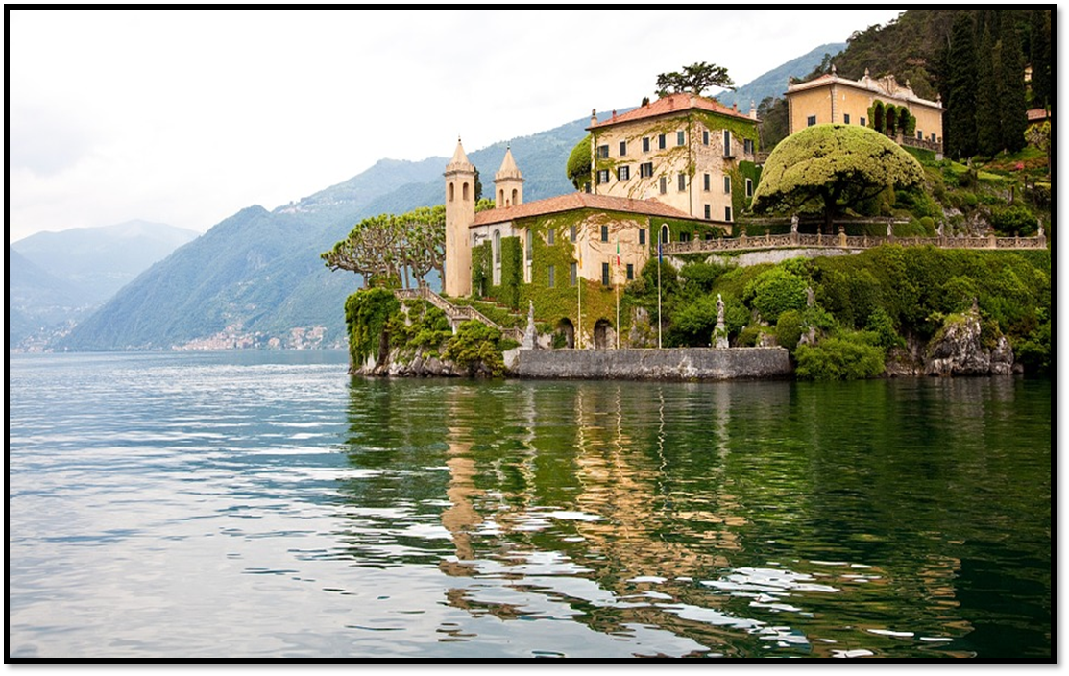
Do Now: What’s The Story?
Think of the most obvious story idea. Then get rid of that.
For top sets, you want to be original.
Imagine this is the beginning of the story. Write your ideas (multiple)down.

Slide 31
The Great Gatsby: Q5
3
Wednesday, 28 March 2018

Slide 32
Lesson Objectives:
To revise the skills needed for English Language ‘Explorations in Creative Reading’
To review the Assessment Objectives
To understand the different elements to the exam
To attempt a Q5
Lesson Outcomes:

Slide 33
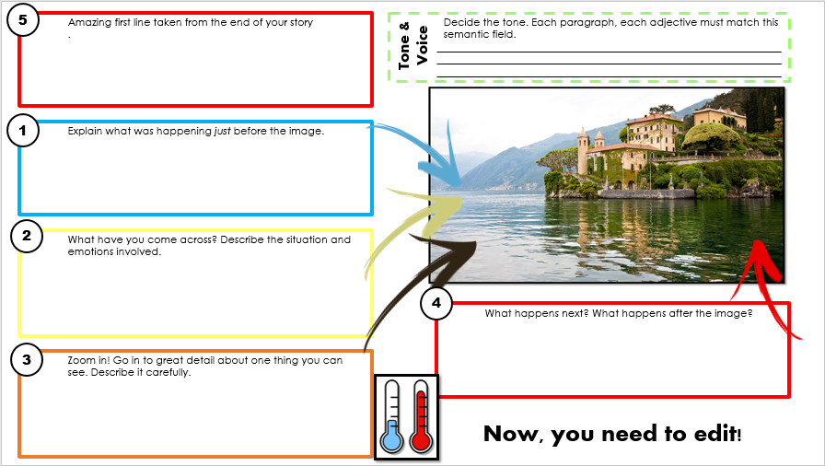
Homework: Due next lesson
Use the planning steps sheet to improve and complete the remaining steps of your story.

Slide 34
Starter
The Fault In Our Stars
Late in the winter of my seventeenth year, my mother decided I was depressed, presumably because I rarely left the house, spent quite a lot of time in bed, read the same book over and over, ate infrequently, and devoted quite a bit of my abundant free time to thinking about death.
How can we tell the personality of the writer when reading a story?
This is called the ‘tone’ of the text. BUT what methods could a writer use to convey this tone to the reader?
The Hate You Give
I shouldn’t have come to this party.
I’m not sure I belong at this party. That’s not on some bougie stuff, either. There were just some places where it’s not enough to be me. Either version of me.
Mockingjay
I stare down at my shoes, watching as a fine layer of ash settles on the warm leather. This is where the bed that I shared with my sister, Prim, stood.
Identify the personality (tone) if the writer in these four texts. Then annotate with what made you come to this conclusion.
Wonder
I know I’m not an ordinary ten-year-old kid. I mean, sure, I do ordinary things. I eat ice cream. I ride my bike. I play ball. I have an Xbox. Stuff like that makes me ordinary. I guess. And I feel ordinary. Inside. But I know ordinary kids don’t make other ordinary kids run away screaming in playgrounds. I know ordinary kids don’t get stared at wherever they go.

Slide 35
The Plan
A lot of you don’t see the point in planning. The best writers alive today only do so well due to extensive planning. Today, you are going to plan your story.
Use your planning sheet to help you plan the order of your story. Each paragraph should be littered with all of the features of sophisticated, descriptive writing that are in the semantic field of your tone.
Start with blue (1), as the colours get warmer, your writing needs to increase in tension.
Then, the last thing that you write should be your first line. It should be taken from the action of the story so that your story beings with a ‘hot’ start.

Slide 36
5
Amazing first line taken from the end of your story.
Decide the tone. Each paragraph, each adjective must match this semantic field.
_________________________________________________________________________________________________________________________________________________________________________________________________________
Tone & Voice
1
Explain what was happening just before the image.
2
What have you come across? Describe the situation and emotions involved.
4
What happens next? What happens after the image?
3
Zoom in! Go in to great detail about one thing you can see. Describe it carefully.
Now, you need to edit!

Slide 37
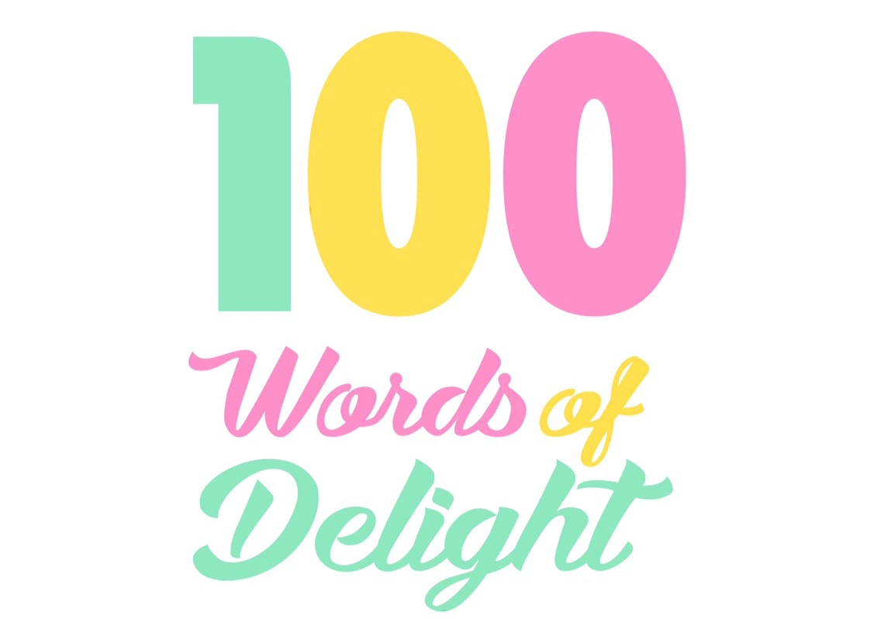
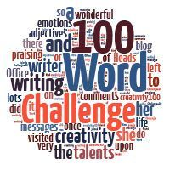
Writing Time
You now have the next ten minutes to write the first one hundred words of your story.
After completing Paper One Q2 & 3, you should know what makes a good piece of creative writing. Now it’s time to write one.
One hundred words. No more. No less.
EXT: Include a semantic field in your writing to add to the tone.

Slide 38
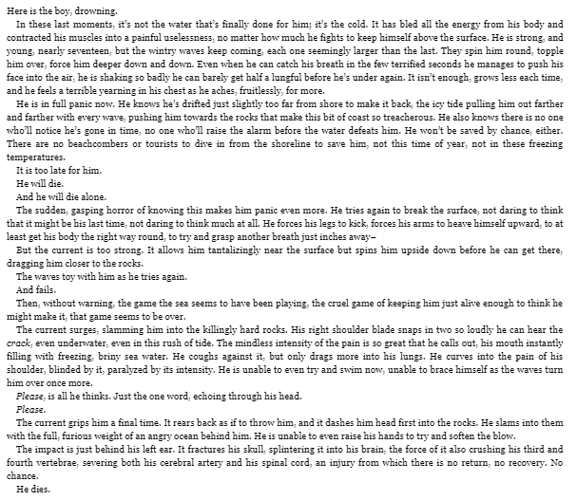
More Than This by Patrick Ness
Left half of the room:
Focus on language in groups of 4. Each of you is responsible for annotating and analysing the text in the following high level areas:
Sophisticated vocabulary
Language devices
Connected ideas.
Tone & reader engagement
Right half of the room:
Focus on structure in groups of 4. Each of you is responsible for annotating and analysing the text in the following high level areas:
Sentences
Paragraphs
Sentence openers
Punctuation

Slide 39
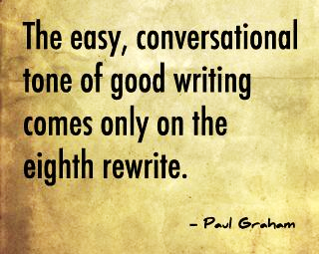
More Than This
Feedback what you have learned about your area of expertise to the rest of your four-person group.
Now, structure and language groups need to swap ideas.
Unless your response if 40/40, you should not be sat doing nothing! The best writers are the ones that re-write!
3) You now have a success criteria of what makes an excellent piece of writing in terms of both language and structure. You should use this to improve your own piece of writing with a red pen.

Slide 40
Plenary
What have you learned about what makes a good piece of creative writing?
What have you altered in your improved (red) story? What have you included to ensure that you are achieving or exceeding your MTG?

